Slide 1

Internet and Internet Services

Slide 2
Introduction to Internet
History of Internet
Internet Architecture
Managing the Internet
Internet Connections
IP Address and Domain Name System
Client-Server Architecture
Hyper Text Transfer Protocol(HTTP)
Electronic Mail(Email)
Connecting to Internet
TABLE
OF
CONTENT

Slide 3
File Transfer Protocol(FTP)
World Wide Web
Remote Login(TELNET)
Static and Dynamic Web Pages
Search Engines
E-commerce
E-governance
Smart City
Censorship and Privacy
TABLE
OF
CONTENT

Slide 4
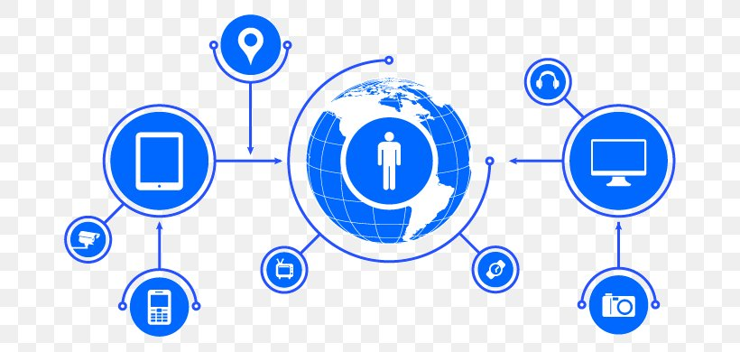
Introduction
Global communication system
Links computer
networks
Network of networks
Vast range of
information resources
Abbreviation of internetwork

Slide 5
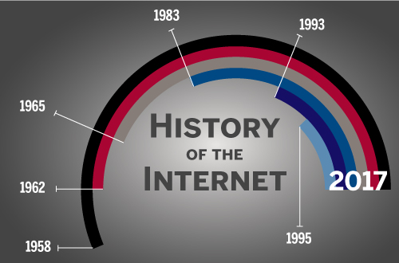
History of Internet
ARPANET in 1960
Project of US department of defense
First WAN
Evolved from ARPANET
Commercialization of internet in 1989
World’s largest network

Slide 6
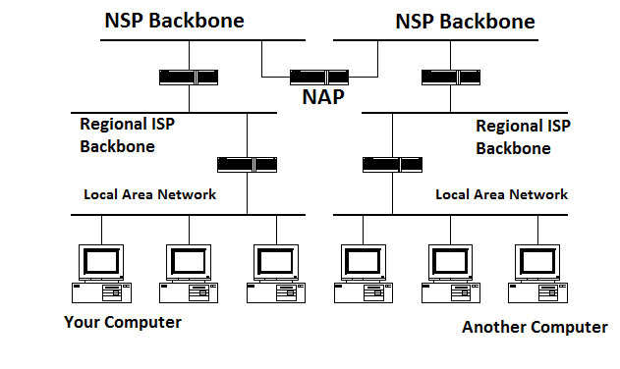
Internet Architecture
Meta-network
Congregation of
distinct network
Interacts with common protocol
Hierarchical architecture
Includes:
Client
Local Network
Regional ISP
Backbone

Slide 7
Managing the Internet
Management not done individually
Participation of many organizations
Government bodies of internet
Internet Society(IOSC)
Internet Architecture Board(IAB)
Internet Engineering Task Force(IETF)
Internet Engineering Steering Group(IESG)
Internet Research Task Force(IRTF)
Internet Assigned Number Authority

Slide 8
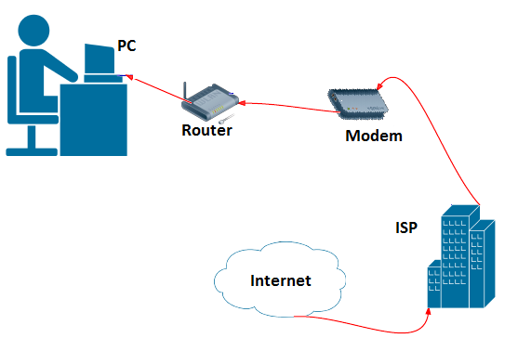
Connecting to Internet
Connection to access internet
Require to exchange data
Requirements for connection
Internet service provider (ISP)
Modem
Router
TCP/IP enabled computer

Slide 9
Internet Connection
Based on cost and bandwidth
ISPs provide Internet connections of different types:
Dial-up Access
Leased Line
Integrated Services Digital Network (ISDN)
Digital Subscriber Line (DSL)
Cable Modem

Slide 10
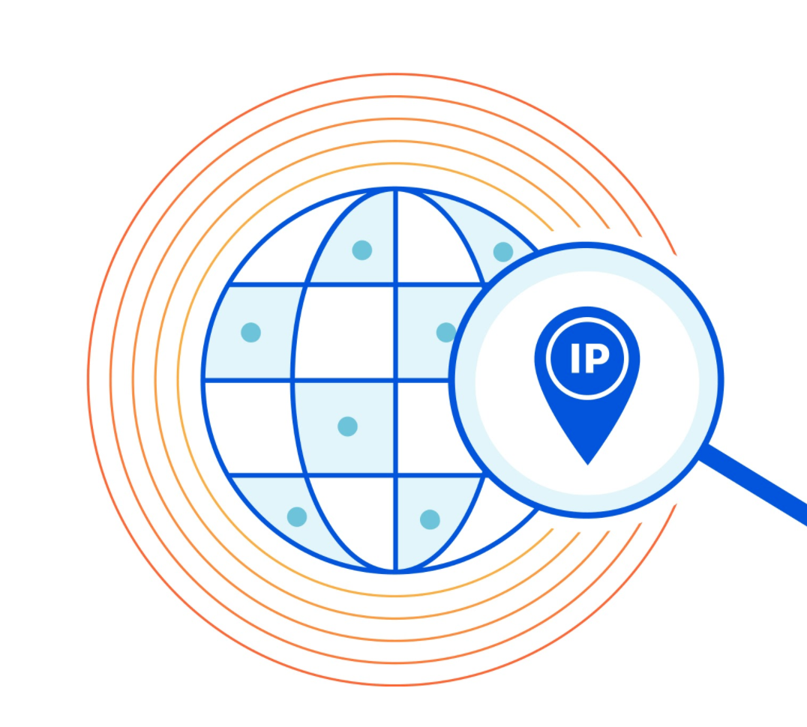
IP Address
Series of numbers
Identifies devices on network
Numeric label connected to computer network
Provides location of the host in network
an example address might be 192.158

Slide 11
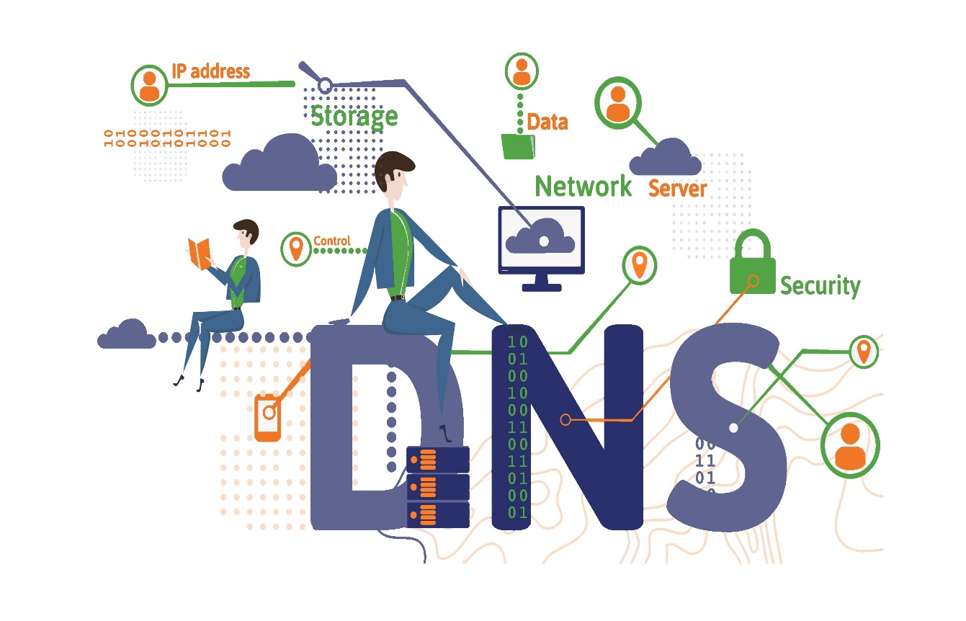
Domain Name System(DNS)
Phone book of internet
Hierarchical and decentralized
naming system
Translates domain names to IP address
Browsers loads internet resources

Slide 12

Client Server Architecture
Emerged in US in early 1980s
Computing model
Delivers and manages resources
Follow common communication protocols

Slide 13
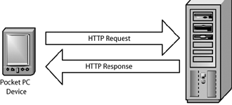
Hyper Text Transfer Protocol
Networking protocol
Distributes information systems
Used for exchanging files on the WWW
Used to transfer the data
Transmits hypertext based documents

Slide 14
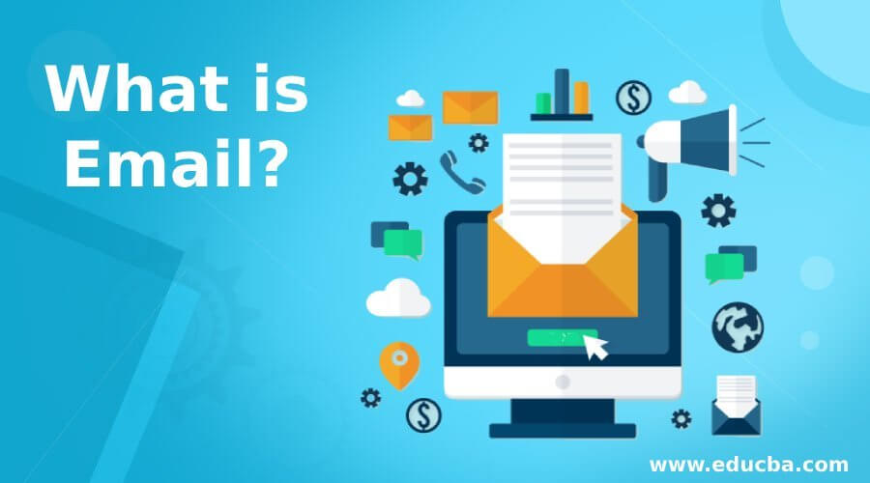
E-mail
Message transfer and
received
Uses computer through network
Use to share photos and videos
Allows sending information

Slide 15

File Transfer Protocol
Allows to transfer multiple files
Ability to resume transfer files
If the connection is lost
Allows you to schedule transfer

Slide 16

WWW
Abbreviation of World Wide Web
Interlinked hypertext
document
Dominant software platform
Primary tool to interact on internet
connected system of public webpage

Slide 17

Remote login (TELNET)
Permits user to interact with
program on another computer
Internet’s remote login service is
TELNET
TELNET stands for Terminal Network
Protocol that allows you to connect to remote computers

Slide 18
Static and Dynamic web pages
Static web pages | Dynamic web pages
Static web pages will remain same until someone changes it manually. | Dynamic web pages have the capacity to produce distinctive content for different visitors.
Pages are simple to design in terms of complexity. | Pages are complicated to construct.
It is written in languages such as HTML, JavaScript, CSS, etc. | It is written in languages like CGI, AJAX, ASP, ASP.NET, etc.
Change of information occurs rarely. | Change of information occurs frequently.
Static we page takes less time for loading than dynamic web page. | Dynamic web page takes more time for loading than static web page.
In Static web page, database is not used. | In Dynamic web page, database is used.

Slide 19

Search Engines
Software system designed to carry out web searches
Helps to find the information online using keyword
Able to return results quickly
Example :Google, Yahoo!, MSN search, etc.

Slide 20
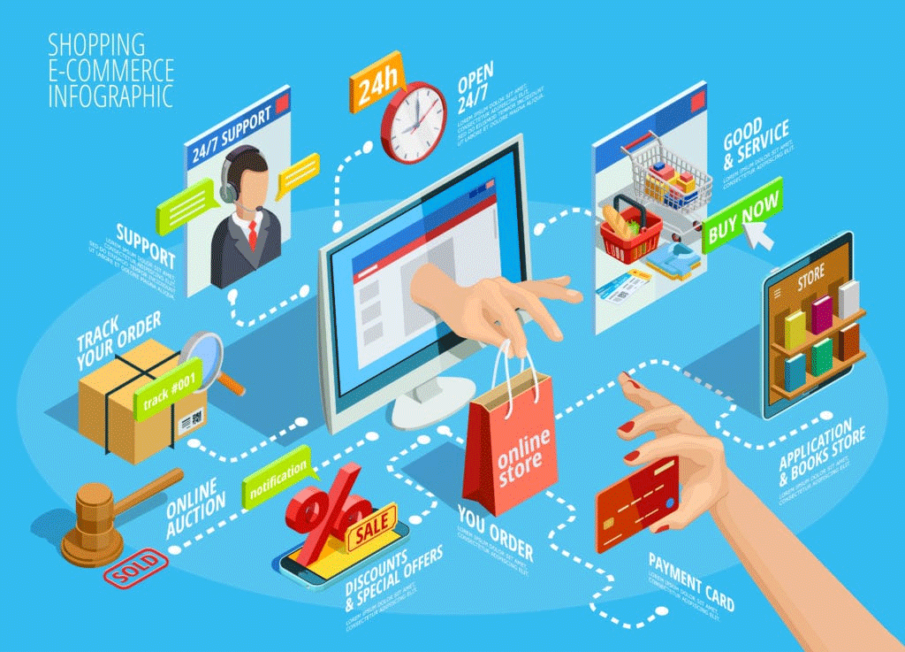
E-commerce
Buying and selling of
product, services and
information
Using electronic media
Conducted over
computers, tablets,
smart phones and other smart devices
Anything purchased through e-commerce
Example :Amazon, Daraz, Sastodeal

Slide 21

E-governance
Use of ICT for delivering of government services
Benefits citizens, business partners and employees
Provides a relationship between government officials and citizens
Transforms traditional government using ICT
Makes government clear, effective and accountable

Slide 22
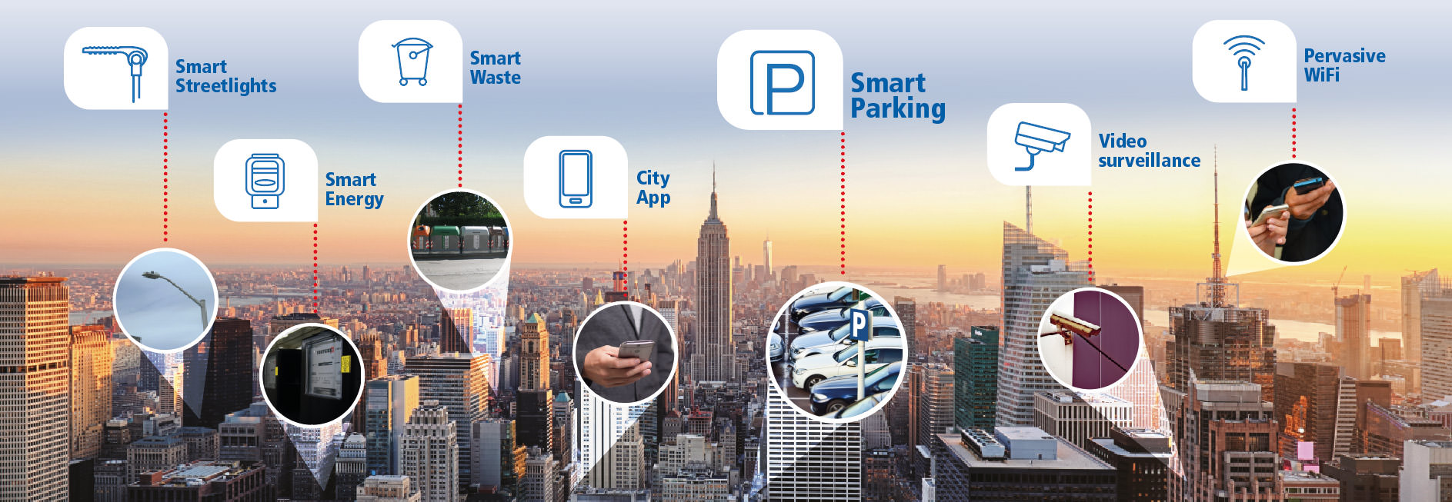
Smart City
Technologically modern urban areas
Uses different types of electronic methods, voice activation and sensors to collect specific data
City that uses technology to provide services
Solves city problems

Slide 23

Censorship
suppression of offensive words, images or ideas
Happens due to imposing their personal, political or moral values
Carried out by government and private pressure groups

Slide 24
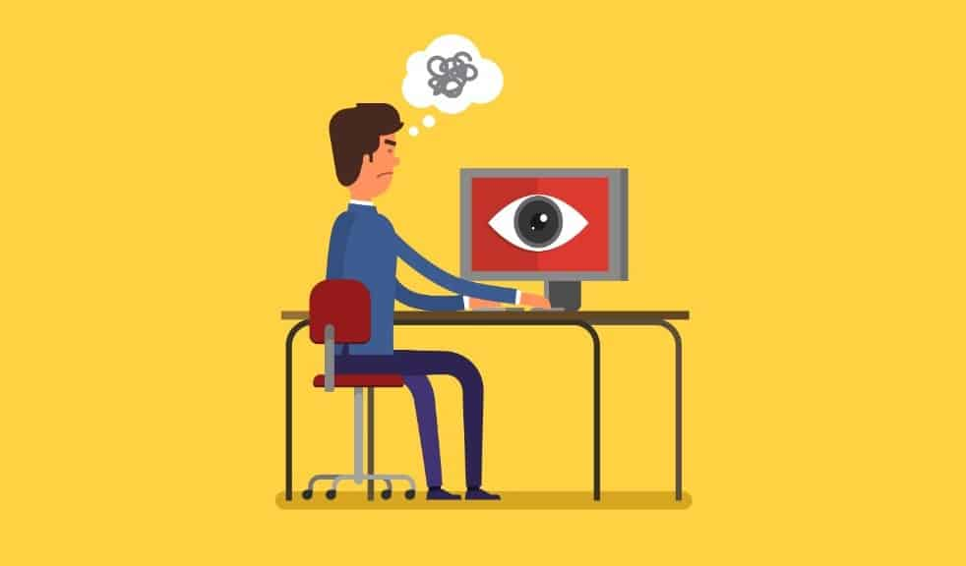
Privacy issues
Issues involving unwarranted access of private information
Privacy issues with data breaches are tracking, hacking and trading

